Slide 1

Syndromic Surveillance (SS)
Validation Tool
Quick Start Guide
Robert Snelick
National Institute of Standards and Technology
December 2, 2015
Contact: rsnelick@nist.gov
Version 1 for Public Comment

Slide 2
http://hl7v2-ss-r2-testing.nist.gov/
Syndromic Surveillance Validation Tool Overview
Purpose: The tool validates Syndromic Surveillance (SS) messages created by Health IT Modules, and Context-based Testing is intended for ONC 2015 Edition certification.
Tool Key Capabilities
Context-free Testing | (No Test Scenario - Test any Syndromic Surveillance message created by EHR) Context is unknown to validation tool Provides a simple and convenient method for testing message structure and most vocabulary
Context-based Testing | (Test Scenarios - Test Syndromic Surveillance message associated with a specific test scenario) Context is known to validation tool All conformance requirements of the SS Implementation Guide can be assessed Used for certifying ONC 2015 Edition Health IT Modules
Profile Viewer | Provides a browsable version of the conformance profile which encapsulates the requirements. Can be used to assist in the interpretation of errors.
Value Set Browser | Provides a browsable view of the vocabulary requirements. Can be used to assist in the interpretation of value set errors.
Documentation | Provides access to documents that will assist in using the tool (including test procedure, test cases, profile descriptions, vocabulary descriptions and validation tool download).
No registration or log-in credentials are needed. Simply click on the link below and send/paste/load message into tool to obtain a Validation report.
NOTE: The Test Tool (.war file) can also be downloaded and installed locally.
NOTE: Web Application is compatible with Firefox, Chrome, and Safari.
Register to Google Group at: https://groups.google.com/d/forum/hl7v2-syndromic-testing to ask questions and provide feedback.

Slide 3
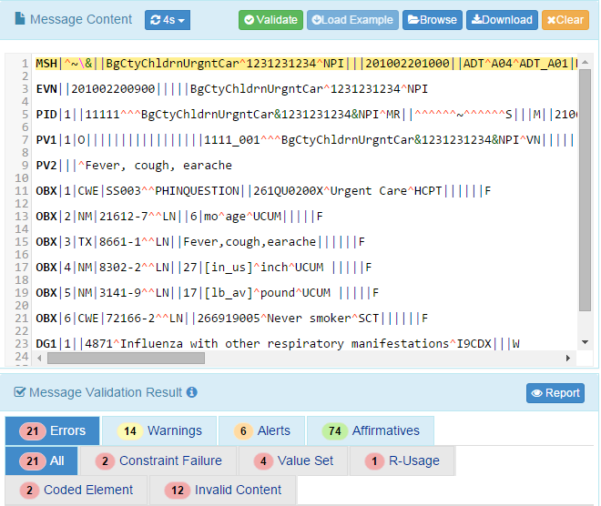
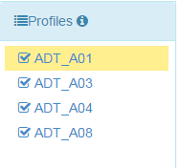
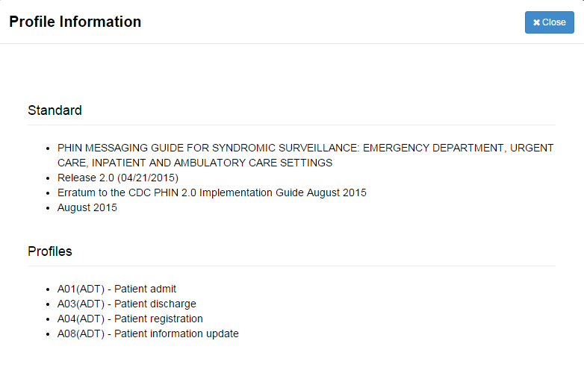
Syndromic Context-free Testing
Profile Viewer page
This page allows tester to view data element information including usage, cardinality, data type, length, table, condition predicate and conformance statements.
Context-free Validation page
This page validates any Syndromic Surveillance message created by the EHR. It is disassociated from a test script, test case, or specific content (test data). Testing will include the technical requirements and content-specific requirements specified in the selected conformance profile.
1
Open Syndromic Surveillance Validation tool using link: http://hl7v2-ss-r2-testing.nist.gov/ and click on ‘Context-free’ Validation tab.
2
Select conformance ‘Profile’ to view profile Information.
3
5
Paste or ‘Download’ your HL7 Message. Validation Results will be shown in the Message Validation Field.
Information on the Standard and the Profiles can be viewed in a pop up screen.
4
6
‘Errors’, ‘Warnings’ and ‘Alerts’ will be displayed. Click the Report tab to display the Message Validation Report ( Shown on Slide 6)
Select the ‘Validation’ tab.

Slide 4
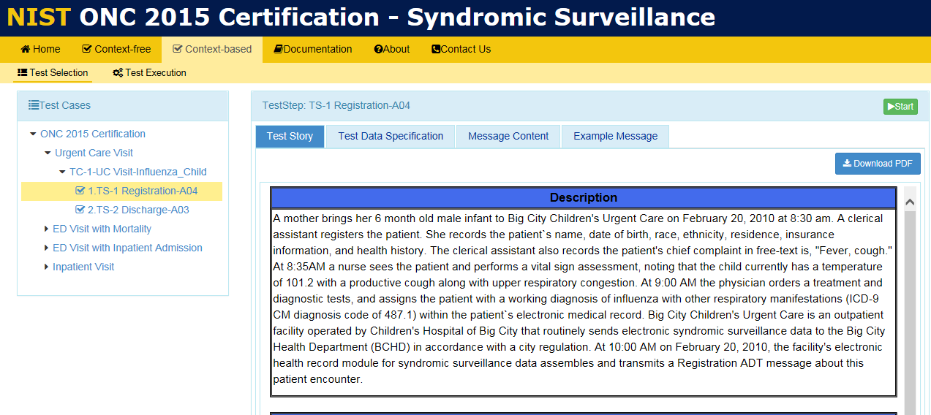
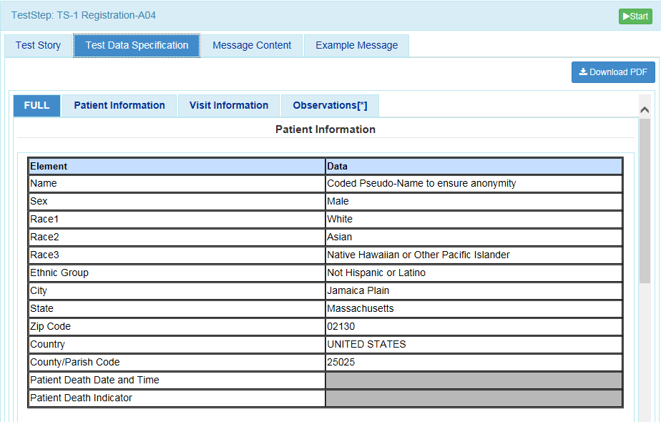
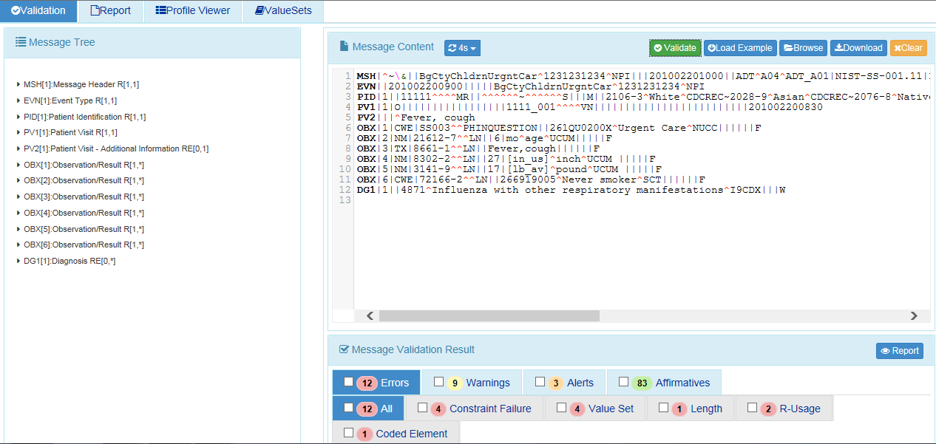
Syndromic Context-based Testing
1
Context-based Validation page
This page validates messages associated with a given test script that includes a specific Syndromic Surveillance test scenario. Testing will include the technical requirements and content-specific requirements specified in the Test Case.
Open Syndromic Surveillance Validation tool using link: http://hl7v2-ss-r2-testing.nist.gov/
and click on ‘Context-based’ Validation tab.
2
Click on arrows to expand the first Test Scenario. Select and expand a Test Step.
3
4
Click on Test Data Specification tab.
Review Test Story.
5
Relevant real-world clinical data is displayed.
6
Create the test message with the EHR technology using the test data provided.
7
8
Click on ‘Start’ button to load Test Step.
Copy/paste or click on ‘Browse’ Message button to upload test message into Message Content window.
10
12
9
Click on ‘Report’ Details icon to display Message Validation Report.
Repeat steps 2-11 for each additional Test Step in Test Case.
Validation results appear. If message failed, errors display.
11
Review Message Validation Results to determine what caused the errors.

Slide 5
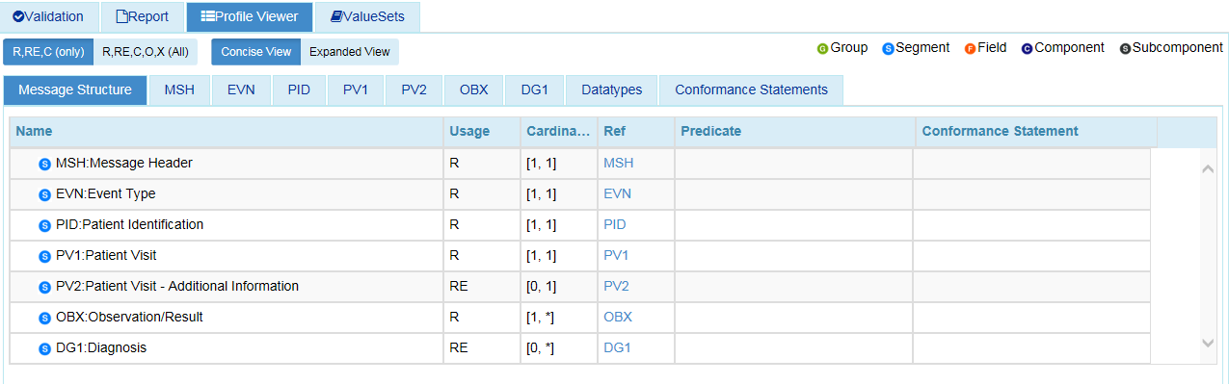
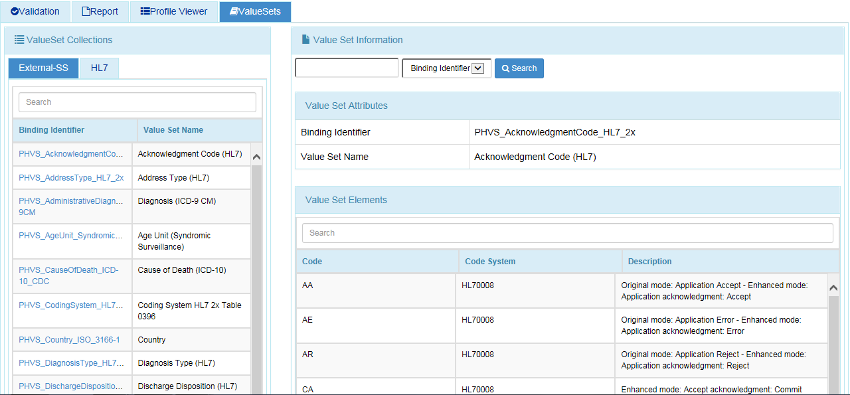
Other Utilities
Profile Viewer page
This page allows tester to view data element information per conformance profile including usage, cardinality, data type, length, table, condition predicate and conformance statements.
Vocabulary page
This page provides the ability to browse the vocabulary requirements. Search capabilities are provided and include searching on value, table name, table ID and description.

Slide 6
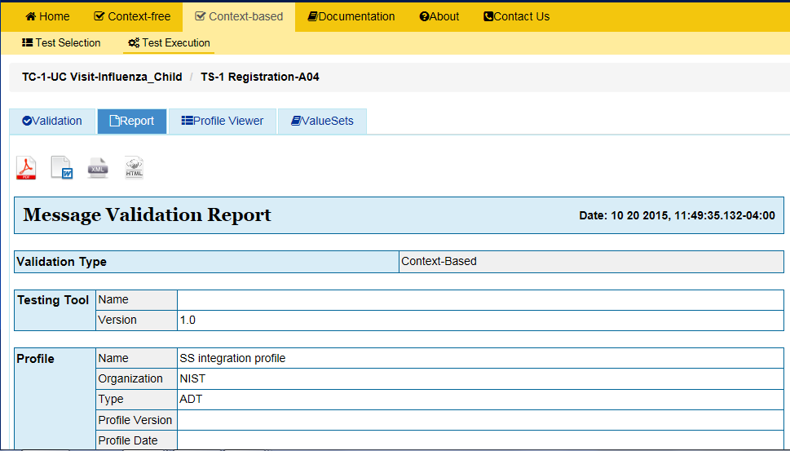
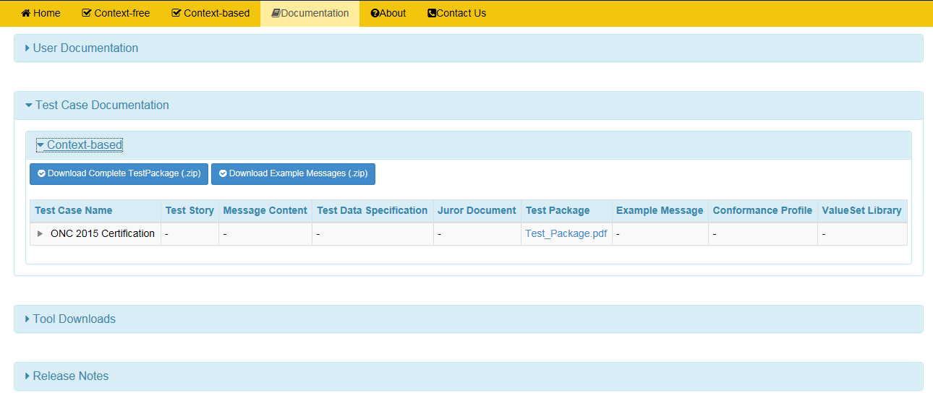
Other Utilities
Message Validation Report
The Message Validation Report is the output of the Syndromic Test Tool. This report states if the test message has passed or failed the test and identifies the points of failure.
Documentation page
The Documentation page provides the ability to download all documents and files for testing, including Test Procedure, Test Cases, Profile and Vocabulary Description files, and validation tool application file (.war file).
1
Message Validation Report may be downloaded as a PDF, XML, Word or HTML file.
2
Message Validation Report may be printed.

